Slide 1

Simple Itinerary Viewer
2023-11-08

Slide 2
Outline
Objective
Methodology
Installation
How to Use
Features

Slide 3
Objective

Slide 4
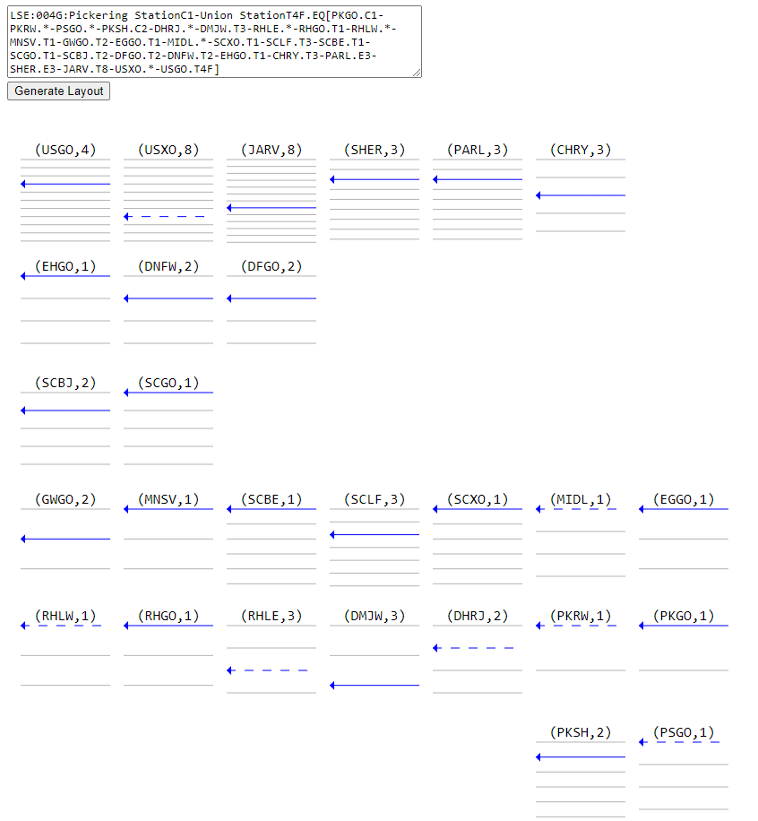
Objective
To provide a simple method for modellers to visualize the location and track numbers in an itinerary.

Slide 5
Methodology

Slide 6
Methodology
The tool is a self-contained website that uses JavaScript to process the itinerary into JSON objects.
It then displays that data visually using SVG in the canvas tag.
The data is visualized as grids of locations with horizontal lines for the tracks.
The track identified in the itinerary string is made dark blue. Dashed blue lines represent guesses for locations that have * for the tracks.
The direction of travelled is inferred from the corridor name and order of the locations.

Slide 7
Installation

Slide 8
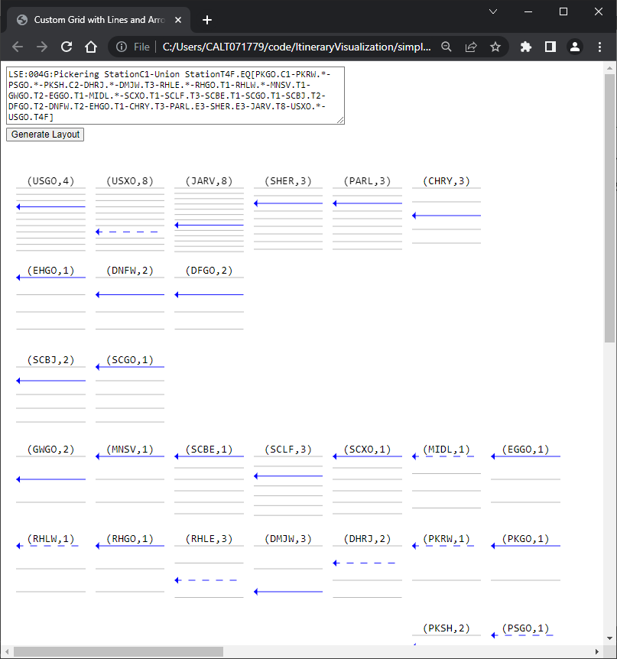
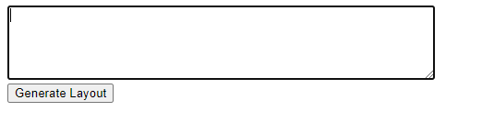
Installation
No installation required. Just open the html file titled “simple_itinerary_viewer.html” in a browser that supports JavaScript (Firefox, Chrome, or Edge). Paste the full itinerary string in the input box and click Generate Layout.
LSE:004G:Pickering StationC1-Union StationT4F.EQ[PKGO.C1-PKRW.*-PSGO.*-PKSH.C2-DHRJ.*-DMJW.T3-RHLE.*-RHGO.T1-RHLW.*-MNSV.T1-GWGO.T2-EGGO.T1-MIDL.*-SCXO.T1-SCLF.T3-SCBE.T1-SCGO.T1-SCBJ.T2-DFGO.T2-DNFW.T2-EHGO.T1-CHRY.T3-PARL.E3-SHER.E3-JARV.T8-USXO.*-USGO.T4F]

Slide 9
How to Use

Slide 10
How to Use – Required Files
Open the html file titled “simple_itinerary_viewer.html” in a browser that supports JavaScript (Firefox, Chrome, or Edge). Paste the full itinerary string in the input box and click Generate Layout.
LSE:004G:Pickering StationC1-Union StationT4F.EQ[PKGO.C1-PKRW.*-PSGO.*-PKSH.C2-DHRJ.*-DMJW.T3-RHLE.*-RHGO.T1-RHLW.*-MNSV.T1-GWGO.T2-EGGO.T1-MIDL.*-SCXO.T1-SCLF.T3-SCBE.T1-SCGO.T1-SCBJ.T2-DFGO.T2-DNFW.T2-EHGO.T1-CHRY.T3-PARL.E3-SHER.E3-JARV.T8-USXO.*-USGO.T4F]

Slide 11
Features

Slide 12
Features
Shows # of tracks per location
Highlights the used track in dark blue
Direction is shown by the animation and arrow
Dashed lines indicate guessed tracks for locations with Asterix

Slide 13
Thank You

